Slide 1
Modelling eye tracking dynamics with quantum theory
Irina Basieva (City University London)
Agnes Sholz (University of Zurich)
Albert Barque-Duran (City University London)
Andreas Gloekner (Max Planck Institute for Collective Goods)
Bettina von Helversen (University of Zurich)
Emmanuel Pothos (City University London)

Slide 2
Do eye tracking dynamics allow insight into decisions?
(Can we model eye tracking dynamics at all.)
Can momentary shifts in attention inform important behavioural variables? (e.g., decision, confidence, personal relevance).
There is some evidence that this is the case:
The well-known gaze-cascade effect (Fiedler & Gloekner, 2021; Krajbich et al., 2010; Shimojo et al., 2003).
Some modelers purport to constrain the architecture of their models, from eye tracking data.

Slide 3
Do eye tracking dynamics allow insight into decisions?
Two examples of this:
In the Attentional Drift-Diffusion Model (aDDM; Krajbich et al., 2012) diffusion rates are affected by fixations, longer fixations for an option increase preference for this option, last fixation has a large impact on choice.
Noguchi & Stewart (in press) based their multivariate decision by sampling model (MDbS) on insights from eye tracking:
attention fluctuates between alternatives on a single attribute at a time
more similar alternatives receive more attention
the gaze cascade effect

Slide 4
Do eye tracking dynamics allow insight into decisions?
But there are undermining considerations as well.
Notably, there is plenty of research on attentional biases related to psychopathology (Cox et al., 2006).

Slide 5
Do eye tracking dynamics allow insight into decisions?
Attentional biases for the stimuli/ information in a decision task could arise in ways (ostensibly) irrelevant to the decision itself.
Note this picture is complicated, since there is debate as to whether attentional biases contribute to related behaviour or not.
Some research argue that attentional biases contribute to relevant behaviour (Calitri et al., 2010), others claim that attentional biases are more incidental.

Slide 6
Do eye tracking dynamics allow insight into decisions?
The most influential tradition for modelling decision dynamics is drift diffusion models.
Such models could in principle be employed to model eye tracking dynamics too, e.g., in decision paradigms.
But, we think there are 3 factors that recommend exploring a formalism with a different philosophy:
Drift diffusion models are rarely fitted to eye tracking dynamics in decision paradigms (emphasis on choice, sometimes RT).
Existing formalisms constrain somewhat rigidly decision paradigms, to bivalent decisions based on matched attributes.
We have an intuition for eye tracking dynamics of multiple reversals followed by stabilization and we think that existing formalisms are less well suited for this pattern.

Slide 7
Do eye tracking dynamics allow insight into decisions?
The data we aim to model is eye tracking data (for which reversals followed by stabilization is perhaps reasonable – but still awaits empirical confirmation).
However, there would be decision cases that display similar characteristics, esp. for options characterized by vaguely specified, unmatched attributes.

Slide 8
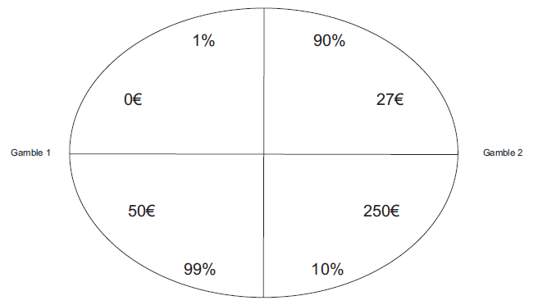
Do eye tracking dynamics allow insight into decisions?
From Gloekner & Herbold (2011), an eye
tracking decision making study.

Slide 9
Outline of paradigm
Three scenarios, participants have made a decisions as if ‘in the shoes’ of the protagonists.
buying a house
going to the cinema
keeping a stray dog
For each decision there are pros and cons.
Each pro would be a simple statement, summarized by the label.
Procedure: first participants see the full arguments with the labels; then they just see the labels and have to make a decision.
In a pretest we had participants rate the pros, cons and we determined a final list with a view to achieve a better balance.

Slide 10
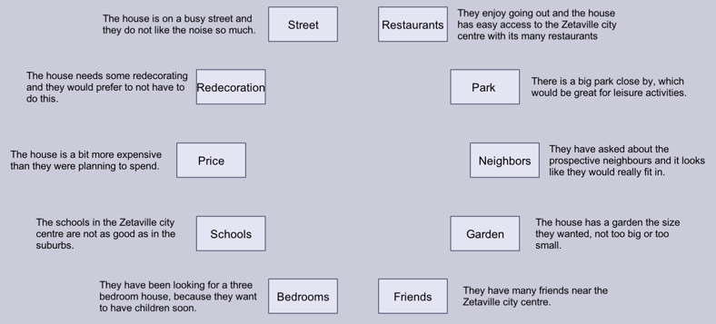

Slide 11
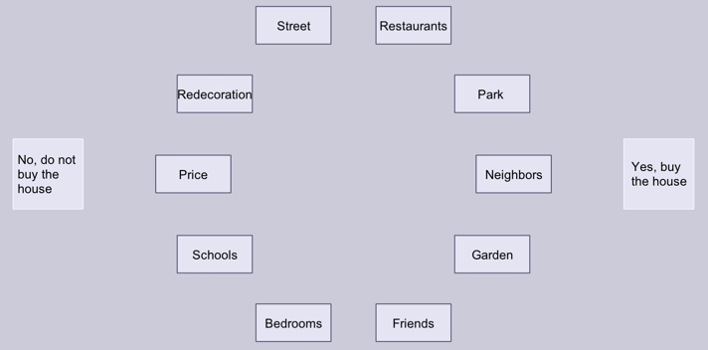

Slide 12
Outline of the paradigm
Obvious disadvantages:
It is hard to distinguish between an information processing step and a decision step.
The actual labels themselves may generate attentional biases, possibly irrelevant to the decision process.
Obvious advantage:
We study decision dynamics in a situation analogous to many everyday ones.

Slide 13
Modelling eye tracking dynamics
Do we need a new formalism?
This is based on a priori expectation, before any data, but still reasonable expectation (oscillation followed by stabilization).
We consider briefly Decision Field Theory (DFT; Busemeyer & Townsend, 1993), multivariate DFT (MDFT; Johnson & Busemeyer, 2005), multivariate linear ballistic accumulation model (MLBA; Trueblood et al., 2014), and MDbS (Noguchi & Stewart, in press).

Slide 14
DFT
Two options are evaluated on a single attribute.
A stochastic sampling process determines momentary evaluations and so shifts in preference towards one or the other option.
At most a single reversal (if the evidence supports the initially disfavoured option).

Slide 15
MDFT
Two options are evaluated on the basis of multiple attributes.
Attention switches focus from attribute to attribute based on some fixed transition probabilities
Based on the currently activated attribute, a comparison is made and preference increases for one of the options.
A lateral inhibition mechanism means that evidence for one option suppresses preference for the other option.

Slide 16
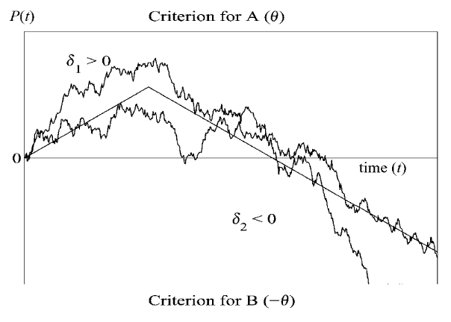
MDFT
Reversals clearly possible, since one attribute may favour one option, and another the other.
The lateral inhibition mechanism possibly works against multiple reversals.
From Diederich (2003), simulated MDFT preference (delta)
plotted over time.

Slide 17
MLBA
No lateral inhibition.
Evidence accumulation for each alternative depends on an overall drift rate.
This is computed based on weighted differences between the target alternative and the other ones.
Current form: as the drift rate depends on all attributes, there is limited room for the relative drift rates to change with time (apart from noise), and so limited room to predict multiple reversals.
But, where there are many pros, cons, one could have a sampling mechanism, such that at different time steps different subsets of pros or cons are selected, leading to likewise different (and possibly reversed) drift rates.

Slide 18
MDbS
Attribute specific, ordinal comparisons dictate evidence accumulation at each time point.
Attentional focus depends on a similarity function between attributes.
Memory sampling could produce multiple reversals.
Less clear whether a pattern of oscillation followed by stabilization can arise naturally.

Slide 19
Quantum approach
Standard dynamics (most often employed in cognition): unitary.
Persistent oscillatory behaviour.
Common application: in violations of the law of total probability/ sure thing principle (e.g., Pothos & Busemeyer, 2009).
Extension to standard dynamics: open system dynamics (hardly any psychological applications).

Slide 20
Quantum approach
Unitary dynamics: isolated systems. Psychologically, a participant tries to solve a problem based exclusively on the information provided.
Open system dynamics: the system interacts with the environment. Psychologically, a participant tries to solve the problem in a way influenced by his/her general knowledge and experience (cf. Fodor, 1983).

Slide 21
Quantum approach
The mental state of participants engage with any of the scenarios in the present paradigm can be written as:
$\left.|ψ\right\rangle =a\left.|yes\right\rangle +b\left.|undecided\right\rangle +c\left.|no\right\rangle$
This state is called a superposition state and it reflects propensity for any of the three options, based on the modulus of the amplitudes a, b, c.
Note, we employ $\left.|yes\right\rangle =\left(\begin{matrix}1 \\ 0 \\ 0\end{matrix}\right)$, $\left.|undecided\right\rangle =\left(\begin{matrix}0 \\ 1 \\ 0\end{matrix}\right)$, $\left.|no\right\rangle =\left(\begin{matrix}0 \\ 0 \\ 1\end{matrix}\right)$

Slide 22
Quantum approach
We can also express the mental state as:
$ρ=\sum_{i}{c_{i}P_{ψ_{i}}}$, where the $c_{i}$’s are classical probabilities, and $P_{ψ_{i}}=\left.|ψ_{i}\right\rangle \left\langle ψ_{i}|\right.$
$ρ$ is called a density matrix and it reflects classical uncertainty about the state
$ρ$ can be diagonal or have non-zero terms off diagonal. In the former case, we only have classical uncertainty about the true, underlying (but unknown) value of the system (answer to a question).
In the latter case, we have quantum uncertainty too; here, measurements do not just reveal unknown, pre-existing values, but can bring outcomes into being.
The transition from superposition uncertainty to classical uncertainty is the hallmark of open-systems dynamics.

Slide 23
Quantum approach – unitary part
Schrödinger’s equation $\frac{d\left.|ψ\left(t\right)\right\rangle }{dt}=−iH\left.|ψ\left(t\right)\right\rangle$
$\left.|ψ\left(t\right)\right\rangle =e^{−i∙t∙H} \left.|ψ\left(0\right)\right\rangle =U(t)\left.|ψ\left(0\right)\right\rangle$
H: Hamiltonian (dynamical information)
U: a unitary matrix.

Slide 24
Quantum approach – unitary part
We propose $H=\left(\begin{matrix}E0 & d & 0 \\ d & 0 & d \\ 0 & d & E0\end{matrix}\right).$
This embodies a psychological assumption that with time amplitude is transferred from the middle (uncertainty) basis vector to the two basis vectors for the two specific (yes, no) responses.
For simplicity we can set E0=1.
This Hamiltonian produces oscillations at two frequencies.

Slide 25
Quantum approach – open systems part
The other two terms are for
normalization.
Governed by the Lindblad equation:
$\dot{ρ}=−i\left[H,ρ\right]+\sum_{j}{Γ_{j}}\left(C_{j}ρC_{j}^{†}−\frac{1}{2}ρC_{j}^{†}C_{j}−\frac{1}{2}C_{j}^{†}C_{j}ρ\right)$.
The Cj are 3x3 matrices that determine the nature of Lindblad dynamics.
Schrödinger's equation, but for
density matrices.
[A,B]=AB-BA
The $Γ_{j}$ determine the degree of environmental influence on dynamics (but can be absorbed in other parameters).

Slide 26
Quantum approach – open systems part
One plausible Lindblad term is: $a_{12}C_{12}+a_{32}C_{32}$
$a_{12}$ drift rate from uncertainty to yes.
We can also include $a_{21}$, $a_{23}$ Lindblad terms.
$a_{21}$ drift rate from yes to uncertainty.
Overall parameterization: $adjT$, d, $a_{12}$, $a_{32}$, $a_{21}$, $a_{23}$

Slide 27
Quantum approach
adjT is just a time stretching parameter.
Higher values of d correspond to more intense oscillation.
Higher values of the a parameters correspond to drift away from uncertainty to certainty or vice versa.
Key point: high values of d overwhelm these drift rates to produce uncertain outcomes at large times.
Note also: the quantum approach easily extends to multiple options.

Slide 28
Eye tracking experiment
15 participants at the University of Zurich.
Three scenarios House, Dog, Movie.
For each scenario:
Participants read the scenario.
Screen with pros, cons plus summary labels (information processing step).
Screen just with the labels (decision step), until decision.
Screen just with the labels (decision step 2), fixed time of 15s.
Confidence in decision.
Four personal relevance questions.
Ratings for each pro, con.

Slide 29
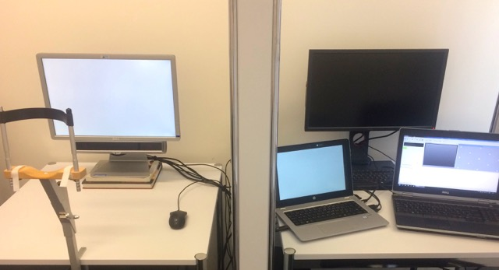
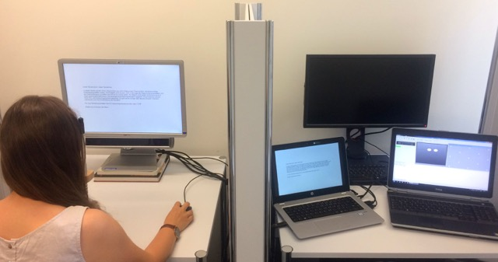

Slide 30
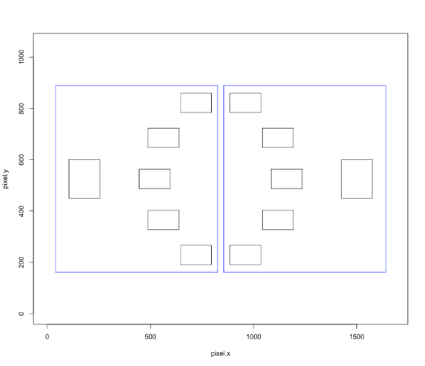
Eye movement analysis
Count fixation durations within time bins of 200ms.
Two AOIs, one for the pros, one for the cons.
Fixation durations in three categories:
pros
cons
neither (when pros, cons durations not sum to 1)

Slide 31
Standard statistical analyses
Can we relate eye tracking structure to behavioural variables?
Note first: we emphasized an expectation of multiple reversals following by stabilization.
This is evident, e.g., for House, Dog, Movie, for decision one we observed M=3.7, 5.7, 6.9 transitions.
We run several backward elimination multiple linear regression analyses, but inconsistent results.

Slide 32
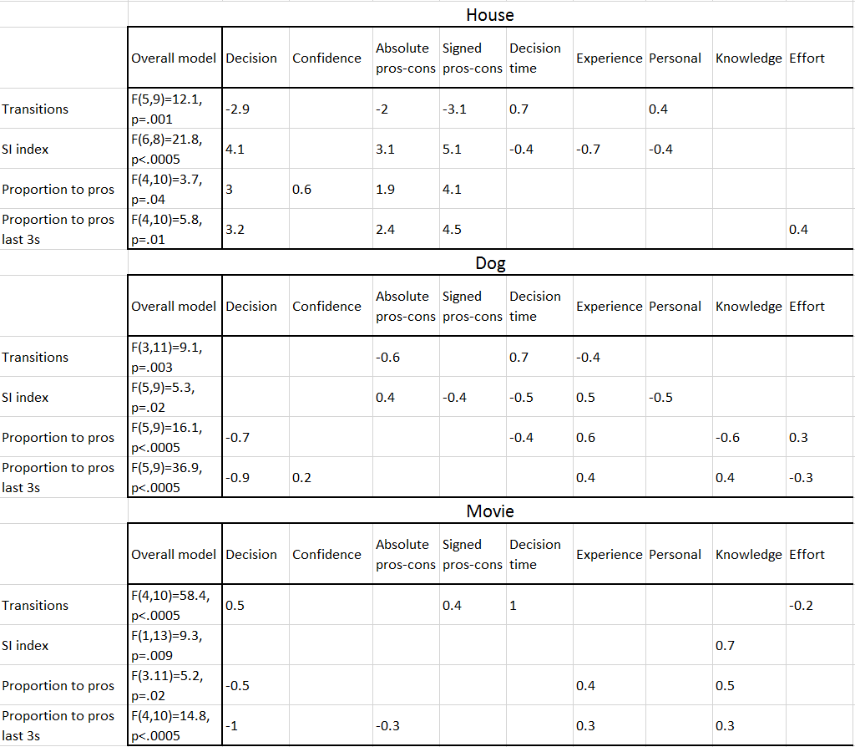
correlations with
proportion vars
look promising.
But signs
inconsistent.

Slide 33
Standard statistical analyses
Overall noisy results. Is it possible to provide a functional description of eye tracking dynamics?
Before this: consider just predicting decision, based on proportion fixation durations and signed pros, cons difference.
Mixed effects logistic regression analysis (random effects: subject, scenario; additional fixed effect: decision phase; diagonal covariance structure, identified with BIC).
Both main effects of signed average pros, cons difference and overall fixation proportions were significant (F(1,86)=13.6, p<.0005; F(1,86)=5.8, p=.018 respectively).

Slide 34
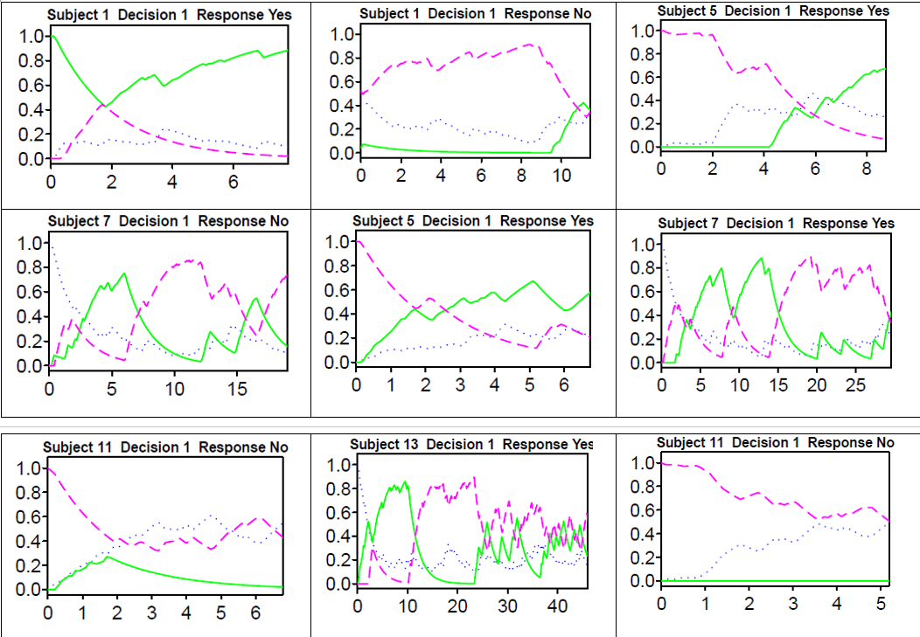
Modelling
House (left), Dog (middle), and Movie (right) scenarios.
Green curve: pros/ yes AOI
Purple dashed line: cons/ no AOI
Blue dotted line: neither (includes eye blinks)
Impression for both oscillation and stabilization,
even if not always in a well-behaved manner of gradually
diminishing oscillation.

Slide 35
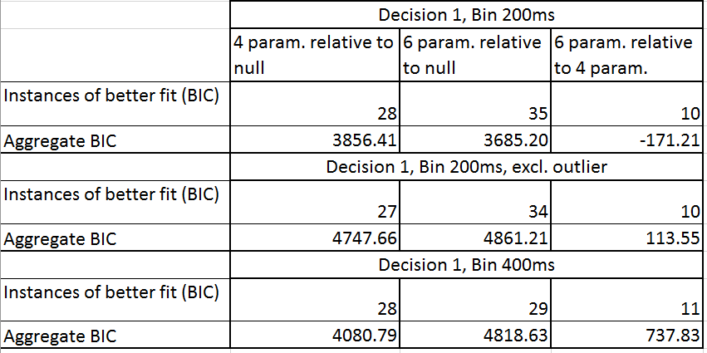
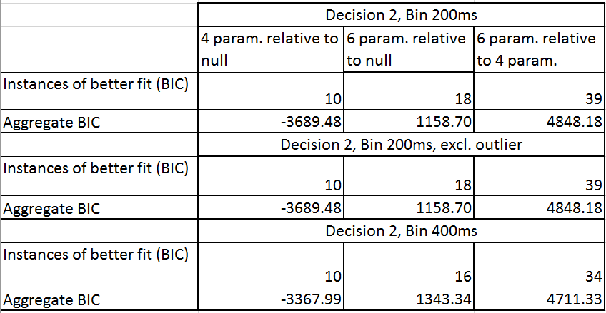
Decision 1: somewhat unclear picture
regarding relative merits of 4 param
OS-QDDM and 6 param one.
(both models better than null)
Decision 2: 6 param OS-QDDM clearly
better.

Slide 36
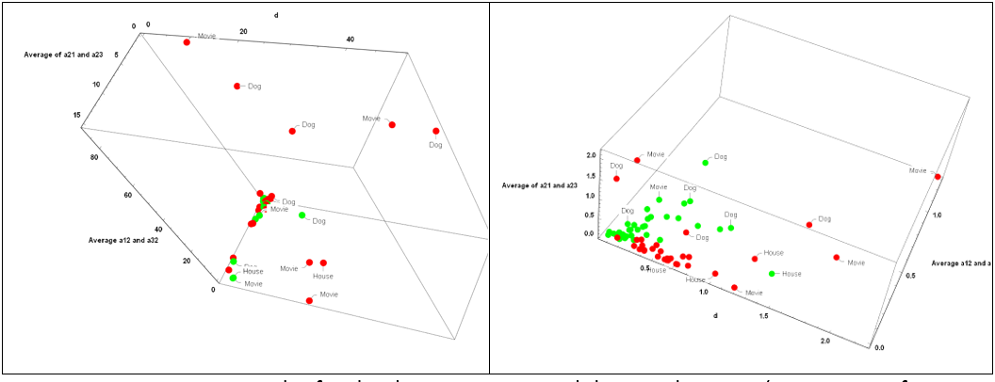
Green points: first decision; red points second decision.
d: higher in second decision; $a_{12}$, $a_{32}$ higher in second decision, higher in Movie, Dog in second decision. (No diff in
first decision.

Slide 37
Modelling
The fits indicate reasonable agreement between model, eye tracking dynamics, despite (apparently at least) noisy results.
We also considered $\left(a_{12}+a_{23}−a_{21}−a_{32}\right)e^{−4d/(a_{12}+a_{23}+a_{21}+a_{32})}$ as a function potentially relating eye tracking structure to decisions.
Motivation: open systems parameters drive dynamics towards e.g. $ρ_{11}(large time)=1$, but d parameter increases ambivalence in the system ($ρ_{11}(large time)=0.5$).

Slide 38
Modelling
Mixed effects logistic regression analysis, participants and scenarios random effects (modelled only with intercepts; diagonal covariance structure, identified by lowest BIC).
Dependent variable decision response.
Fixed effects independent variables: decision phase, the function before.
Significant effect of function: F(1,87)=4.5, p=.04, uncorrected correlation -0.3 (in the expected direction).

Slide 39
Conclusions
Eye tracking structure has not been a focus for direct modelling.
Our purpose was to make a first step in addressing this.
We claim that the pattern of ambivalence followed by stabilization will be relevant in some decisional dynamics cases too.
Present paradigm: aimed to capture such a pattern, but DV measurement restricted to eye tracking dynamics.

Slide 40
Conclusions
The quantum framework is well suited to situations of oscillation followed by stabilization.
Quantum OS dynamics have been well studied and supported by extensive theory; we think it is worth further exploring them in modelling eye tracking structure and decision dynamics generally.

